Slide 1


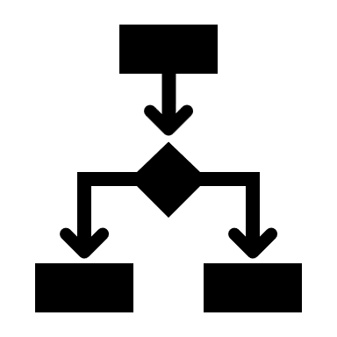
Introduction to System Design
Ahmed Arebie Tripoli Dev-Club 2024

Slide 2

Why We Need A System Design
Ahmed Arebie Tripoli Dev-Club 2024

Slide 3


Why We Need A System Design
Fun Example ☺
Ahmed Arebie Tripoli Dev-Club 2024

Slide 4
Why We Need A System Design
Step = 1 m,
Top Speed = 2 Step/sec,
Top Speed = 2m/sec
Fun Example ☺
Ahmed Arebie Tripoli Dev-Club 2024

Slide 5
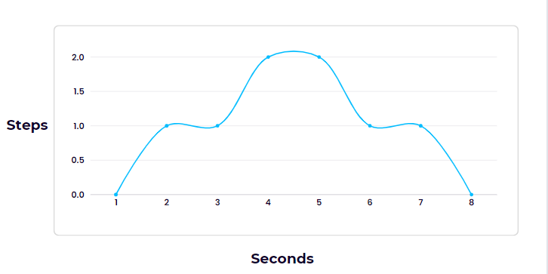
Why We Need A System Design
1 Step = 1m, 8 steps(8m) in 8 sec
Fun Example ☺
Ahmed Arebie Tripoli Dev-Club 2024

Slide 6



Why We Need A System Design
1 Step = 1m, 8 steps(8m) in 8 sec
Fun Example ☺
Ahmed Arebie Tripoli Dev-Club 2024

Slide 7

Why We Need A System Design
1 Step = 1m, 8 steps(8m) in 8 sec
Fun Example ☺
Ahmed Arebie Tripoli Dev-Club 2024

Slide 8
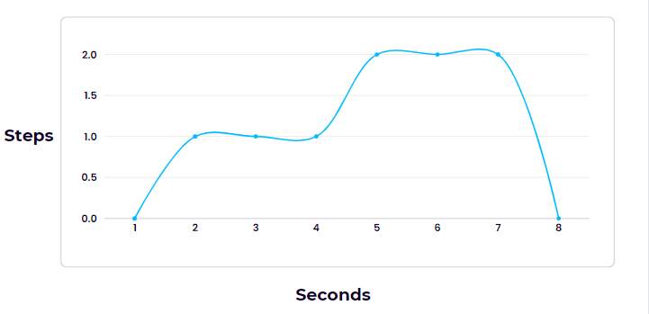
Why We Need A System Design
1 Step = 1m, 9 steps(9m) in 8 sec
Fun Example ☺
Ahmed Arebie Tripoli Dev-Club 2024

Slide 9
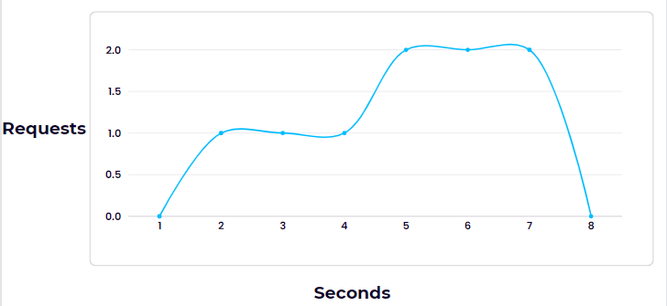

Why We Need A System Design
Fun Example ☺
Ahmed Arebie Tripoli Dev-Club 2024

Slide 10
Why We Need A System Design
Fun Example ☺
Ahmed Arebie Tripoli Dev-Club 2024

Slide 11
Why We Need A System Design
SCALE
Fun Example ☺
Ahmed Arebie Tripoli Dev-Club 2024

Slide 12
Why We Need A System Design
SCALE
SCALE
Fun Example ☺
Ahmed Arebie Tripoli Dev-Club 2024

Slide 13
Why We Need A System Design
SCALE
SCALE
SCALE
Fun Example ☺
Ahmed Arebie Tripoli Dev-Club 2024

Slide 14
Why We Need A System Design
SCALE
SCALE
SCALE
SCALE
SCALE
SCALE
SCALE
SCALE
SCALE
Fun Example ☺
Ahmed Arebie Tripoli Dev-Club 2024

Slide 15
Why We Need A System Design
SCALE
SCALE
SCALE
SCALE
SCALE
SCALE
SCALE
SCALE
SCALE
Fun Example ☺
Ahmed Arebie Tripoli Dev-Club 2024

Slide 16
This is Why We Need A System Design
Ahmed Arebie Tripoli Dev-Club 2024

Slide 17

This is Why We Need A System Design
Ahmed Arebie Tripoli Dev-Club 2024

Slide 18
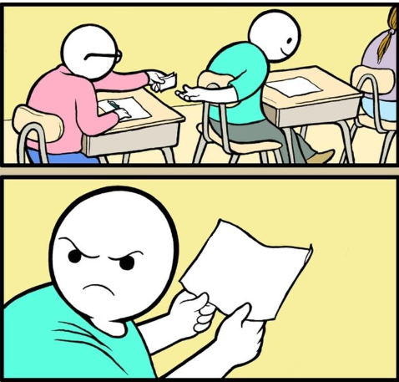
Working With Requirements
Were not going to Talk about system Design we’re going to talk about what do you need to know to learn system design
Were not gonna Talk about system Design we’re ….
Ahmed Arebie Tripoli Dev-Club 2024

Slide 19
Working With Requirements
Meet the two types of the requirements
Ahmed Arebie Tripoli Dev-Club 2024

Slide 20
Working With Requirements
Meet the two types of the requirements
“What the System should Do“
Ahmed Arebie Tripoli Dev-Club 2024

Slide 21
Working With Requirements
Meet the two types of the requirements
“What the System should Do“ - Business Flows. - Business Services. - User Interfaces.
Ahmed Arebie Tripoli Dev-Club 2024

Slide 22
Working With Requirements
Meet the two types of the requirements
“What the System should Do“ - Business Flows. - Business Services. - User Interfaces.
Functional Requirements
Ahmed Arebie Tripoli Dev-Club 2024

Slide 23

Requirements with DDD
SD Strategic Design
TD Tactical design
Bounded Context
Event storming
who do we want in the room, exploring the problem space so we want all the relevant experts in the various fields
big picture, process modeling, software design.
Ahmed Arebie Dev-Summit 2024

Slide 24
Working With Requirements
Meet the two types of the requirements
“What the System should Do“ - Business Flows. - Business Services. - User Interfaces.
Functional Requirements
Ahmed Arebie Tripoli Dev-Club 2024

Slide 25
Working With Requirements
Meet the two types of the requirements
“What the System should Do“ - Business Flows. - Business Services. - User Interfaces.
Functional Requirements
“What Should the System Deal With“
Ahmed Arebie Tripoli Dev-Club 2024

Slide 26
Working With Requirements
Meet the two types of the requirements
“What the System should Do“ - Business Flows. - Business Services. - User Interfaces.
Functional Requirements
“What Should the System Deal With“
Non-Functional Requirements
Ahmed Arebie Tripoli Dev-Club 2024

Slide 27
Working With Requirements
Meet the two types of the requirements
“What the System should Do“ - Business Flows. - Business Services. - User Interfaces.
Functional Requirements
“What Should the System Deal With“ - Performance
- Load
- Data Volume
- Concurrent Users
- SLA
Non-Functional Requirements
Ahmed Arebie Tripoli Dev-Club 2024

Slide 28
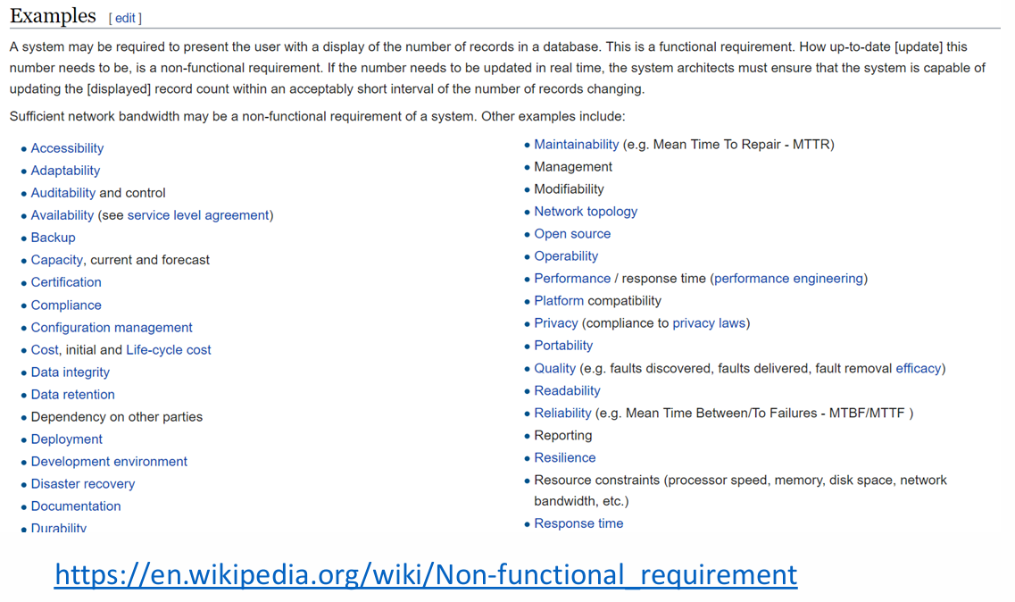

Slide 29
Working With Requirements
Meet the two types of the requirements
“What the System should Do“ - Business Flows. - Business Services. - User Interfaces.
Functional Requirements
“What Should the System Deal With“ - Performance
- Load
- Data Volume
- Concurrent Users
- SLA
Non-Functional Requirements
Ahmed Arebie Tripoli Dev-Club 2024

Slide 30
Working With Requirements
- Performance
Ahmed Arebie Tripoli Dev-Club 2024

Slide 31
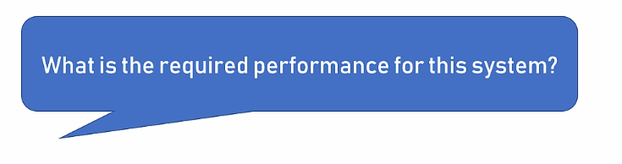
Working With Requirements
- Performance
Ahmed Arebie Tripoli Dev-Club 2024

Slide 32
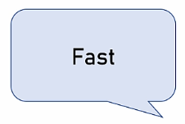
Working With Requirements
- Performance
Ahmed Arebie Tripoli Dev-Club 2024

Slide 33
Working With Requirements
Performance:
1- Always talk in numbers
2- Latency & Throughput
Ahmed Arebie Tripoli Dev-Club 2024

Slide 34
Working With Requirements
Performance:
1- Always talk in numbers
Ahmed Arebie Tripoli Dev-Club 2024

Slide 35

Working With Requirements
Performance:
1- Always talk in numbers
What is Fast !!!
Speed is Relative
Ahmed Arebie Tripoli Dev-Club 2024

Slide 36


Working With Requirements
Performance:
1- Always talk in numbers
1s >
100ms >
Ahmed Arebie Tripoli Dev-Club 2024

Slide 37
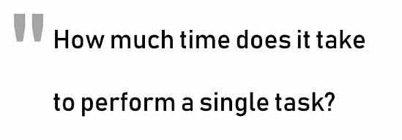
Working With Requirements
Performance:
2- Latency & Throughput
Latency:
Ahmed Arebie Tripoli Dev-Club 2024

Slide 38
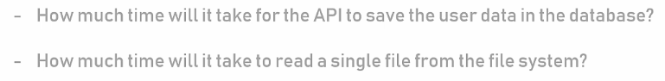
Working With Requirements
Performance:
2- Latency & Throughput
Latency:
Ahmed Arebie Tripoli Dev-Club 2024

Slide 39
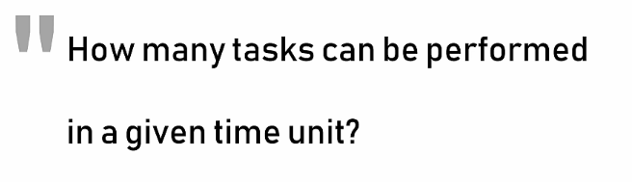
Working With Requirements
Performance:
2- Latency & Throughput
Throughput:
Ahmed Arebie Tripoli Dev-Club 2024

Slide 40
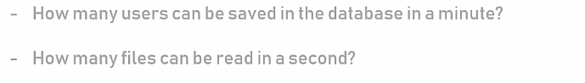
Working With Requirements
Performance:
2- Latency & Throughput
Throughput:
Ahmed Arebie Tripoli Dev-Club 2024

Slide 41
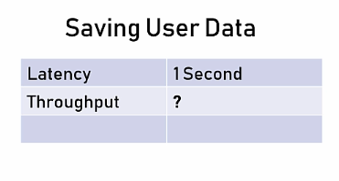
Working With Requirements
Performance:
1- Always talk in numbers
2- Latency & Throughput
In 1min
Ahmed Arebie Tripoli Dev-Club 2024

Slide 42
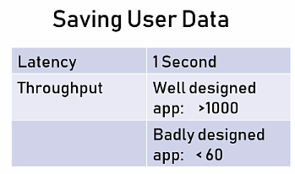
Working With Requirements
Performance:
1- Always talk in numbers
2- Latency & Throughput
In 1min
Ahmed Arebie Tripoli Dev-Club 2024

Slide 43
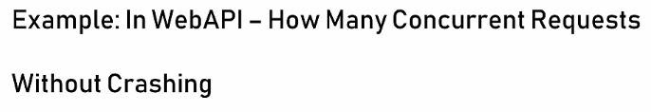
Working With Requirements
Load:
The Quantity of work that the system can do without crashing
Ahmed Arebie Tripoli Dev-Club 2024

Slide 44
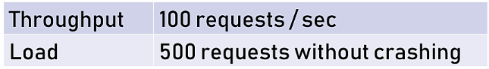
Working With Requirements
Load:
The Quantity of work that the system can do without crashing
Ahmed Arebie Tripoli Dev-Club 2024

Slide 45
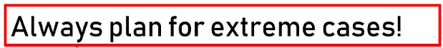
Working With Requirements
Load:
The Quantity of work that the system can do without crashing
Ahmed Arebie Tripoli Dev-Club 2024

Slide 46
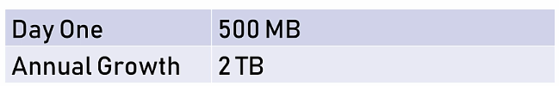
Working With Requirements
Data Volume: - How Much Data the System Will Accumulate Over Time - Helps With:
* Deciding on Database Type
* Designing Queries
* Storage Planning - Two Important Aspects:
1- Data Required on “Day one” 2- Data Growth
Ahmed Arebie Tripoli Dev-Club 2024

Slide 47
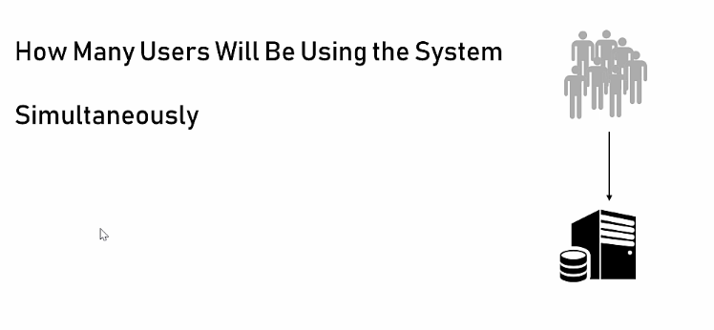

Working With Requirements
- Concurrent Users
Ahmed Arebie Tripoli Dev-Club 2024

Slide 48
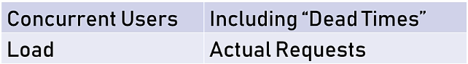

Working With Requirements
- Concurrent Users
Ahmed Arebie Tripoli Dev-Club 2024

Slide 49
Working With Requirements
- SLA: Service Level Agreement
SLA- Service Level Agreement (internal/ external)
SLOs - Service Level Objectives (The Target)
SLIs - Service Level Indicators
Important Considerations
Ahmed Arebie Tripoli Dev-Club 2024

Slide 50
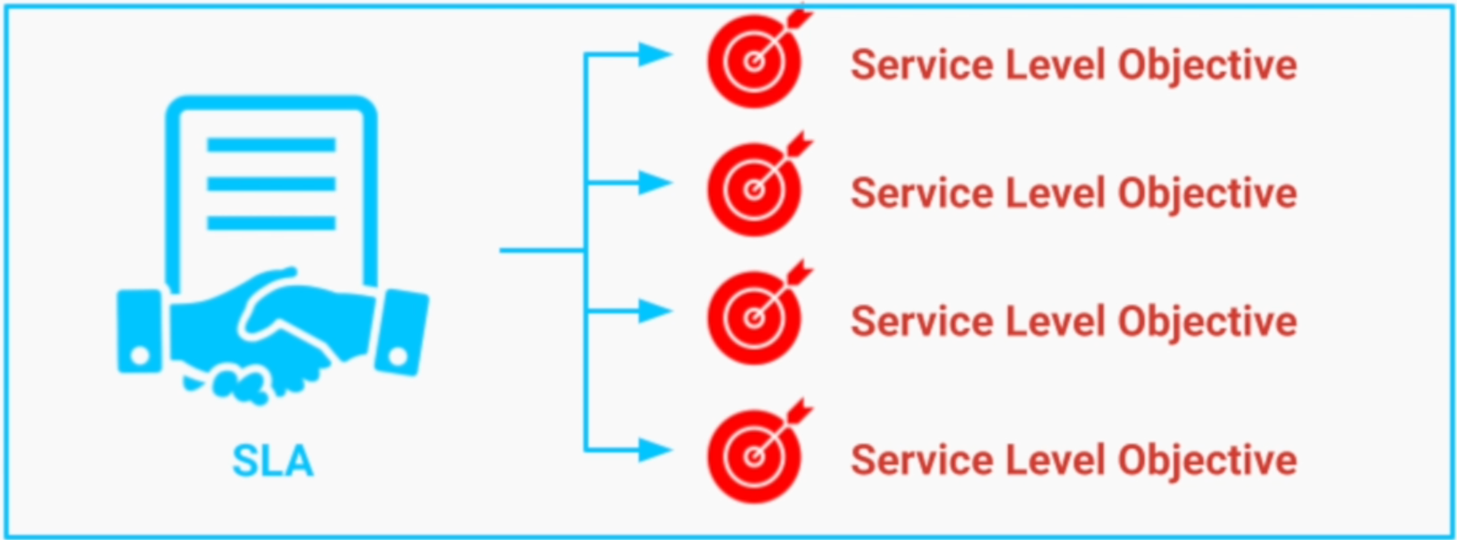
Working With Requirements
- SLA: Service Level Agreement
Ahmed Arebie Tripoli Dev-Club 2024

Slide 51
Working With Requirements
- SLA: Service Level Agreement
SLA- Service Level Agreement (internal/ external)
SLOs - Service Level Objectives (The Target)
SLIs - Service Level Indicators (Actual Hit)
Important Considerations
Ahmed Arebie Tripoli Dev-Club 2024

Slide 52
Meet the *-ilities
*-ilities = Quality Attributes
- Technical capabilities that should be used in order to fulfill the non-functional requirements
Ahmed Arebie Tripoli Dev-Club 2024

Slide 53
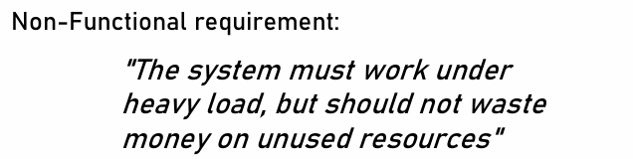
Meet the *-ilities
*-ilities = Quality Attributes
- Technical capabilities that should be used in order to fulfill the non-functional requirements
Ahmed Arebie Tripoli Dev-Club 2024

Slide 54
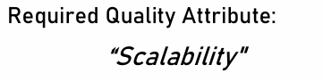
Meet the *-ilities
*-ilities = Quality Attributes
- Technical capabilities that should be used in order to fulfill the non-functional requirements
Ahmed Arebie Tripoli Dev-Club 2024

Slide 55
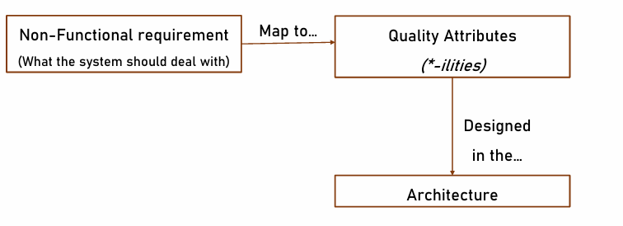
Meet the *-ilities
*-ilities = Quality Attributes
Ahmed Arebie Tripoli Dev-Club 2024

Slide 56
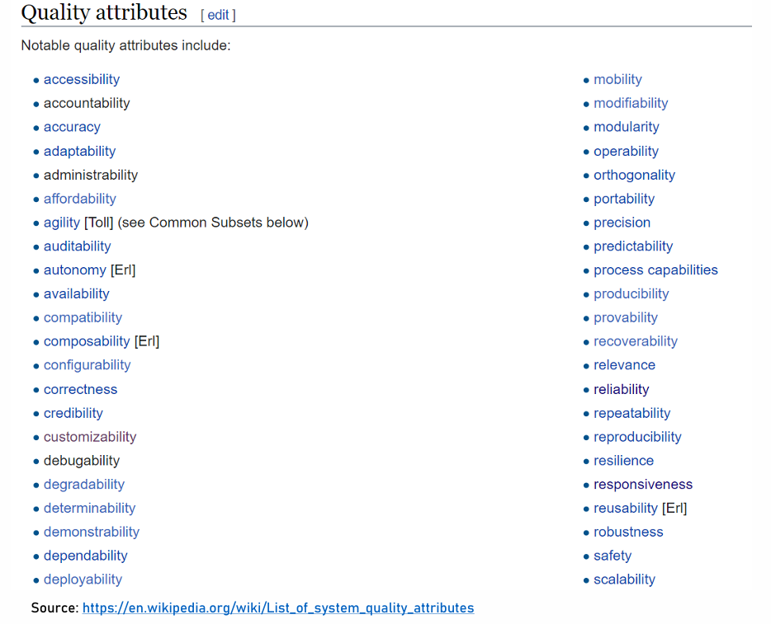
Meet the *-ilities
*-ilities = Quality Attributes
Ahmed Arebie Tripoli Dev-Club 2024

Slide 57
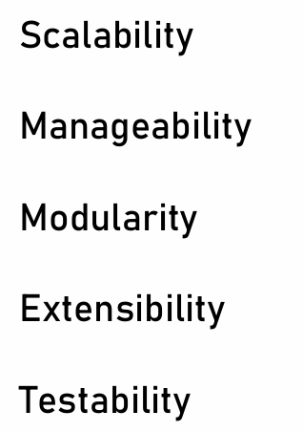
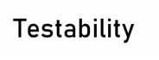

Meet the *-ilities
*-ilities = Quality Attributes
Ahmed Arebie Tripoli Dev-Club 2024

Slide 58
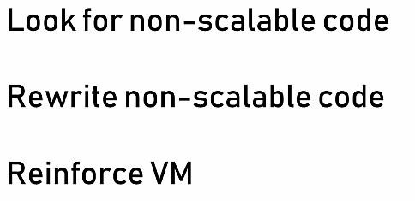
Meet the *-ilities
- Scalability
Ahmed Arebie Tripoli Dev-Club 2024

Slide 59
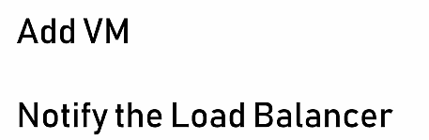
Meet the *-ilities
- Scalability
Non-Scalable System
Scalable System
Ahmed Arebie Tripoli Dev-Club 2024

Slide 60
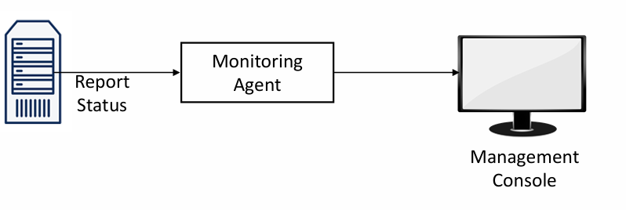
Meet the *-ilities
- Manageability
“Know what's going on and take actions accordingly”
Ahmed Arebie Tripoli Dev-Club 2024

Slide 61
Meet the *-ilities
- Modularity
“system that is built from building blocks, that can be changed or replaced without affecting the whole system.”
Ahmed Arebie Tripoli Dev-Club 2024

Slide 62
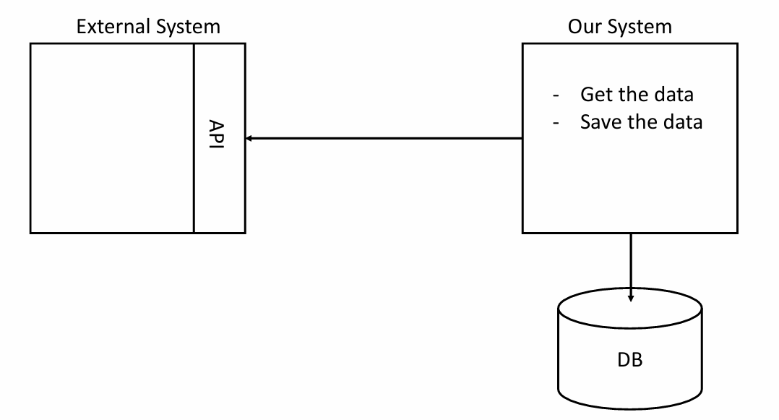
Meet the *-ilities
- Modularity
Ahmed Arebie Tripoli Dev-Club 2024

Slide 63
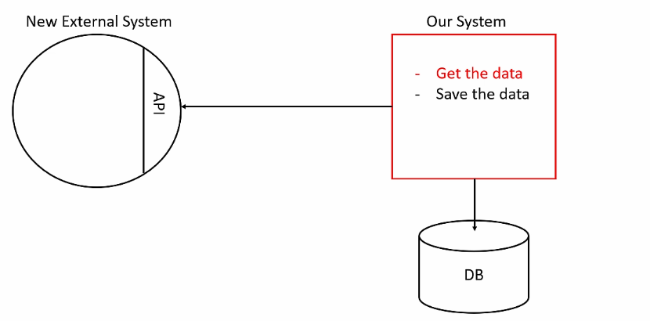
Meet the *-ilities
- Modularity
Ahmed Arebie Tripoli Dev-Club 2024

Slide 64
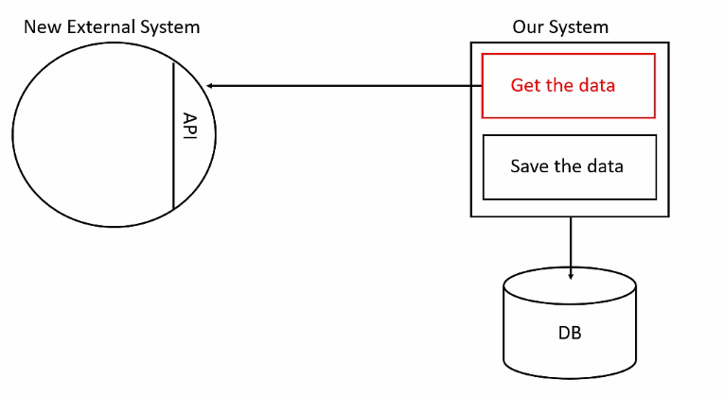
Meet the *-ilities
- Modularity
Ahmed Arebie Tripoli Dev-Club 2024

Slide 65
Meet the *-ilities
- Testability
Types of Tests:
1- Manual Test 2- Unit Test
3- Integration Test
Testability’s Characteristics:
1- Independent modules and methods 2- Single responsibility
Ahmed Arebie Tripoli Dev-Club 2024

Slide 66
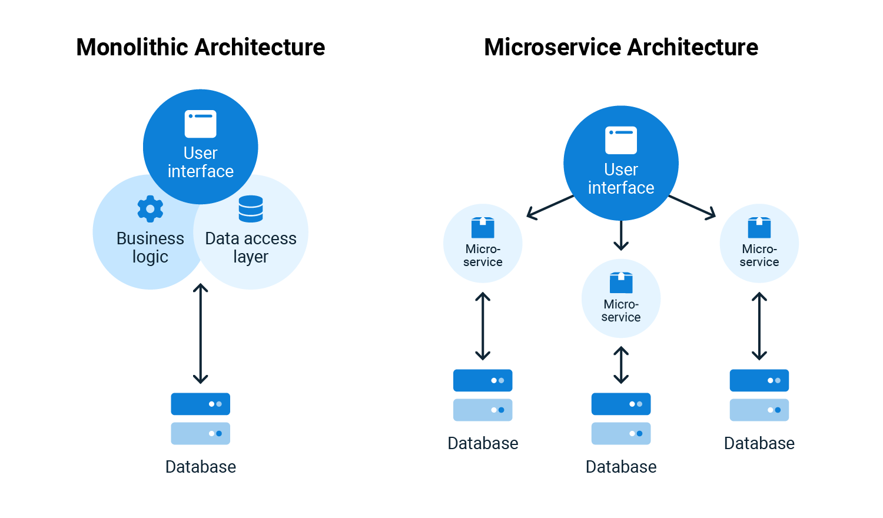
Understanding Software Architecture: From Monoliths / Microservices
Ahmed Arebie Tripoli Dev-Club 2024

Slide 67
Sync and Async process Communication
Synchronous Communication Examples:
HTTP Request-Response:
When a client sends an HTTP request to a server and waits for a response before proceeding.
Example: A user submits a form on a website, and the server processes the request synchronously, responding with a success message or an error message.
Remote Procedure Call (RPC):
In RPC, a client sends a request to a remote server and waits for the server to process the request and return a response.
Example: A client application calls a remote API method over gRPC and waits for the response to process further.
Asynchronous Communication Examples:
Message Queues:
Services can communicate asynchronously through message queues like RabbitMQ or Apache Kafka.
Example: Service A puts a message in a queue, and Service B consumes the message at its own pace, processing it without immediate interaction with Service A.
Publish-Subscribe Pattern:
Services can communicate using a publish-subscribe pattern, where publishers send messages to a topic, and subscribers receive messages from that topic.
Example: Service A publishes a message to a topic, and Service B and Service C (subscribers) receive and process the message independently.
Ahmed Arebie Tripoli Dev-Club 2024

Slide 68
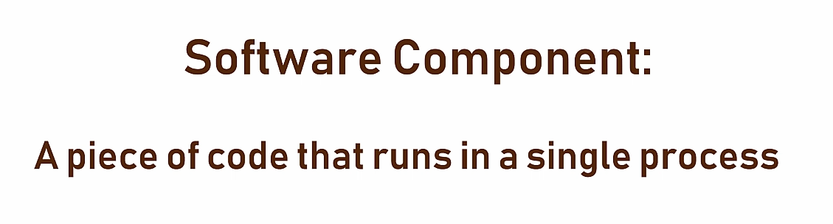
Component architecture and system architecture
Ahmed Arebie Tripoli Dev-Club 2024

Slide 69

Core Principles of Software Architecture
Separation of Concerns (SOC)
Separate Lage blocks with in the application
- Business logic from infrastructure and UI
No link with the low-level implementation
Make it easier to test
Basic idea behind layering code in applications
Ahmed Arebie Tripoli Dev-Club 2024

Slide 70

Core Principles of Software Architecture
Single Responsibility Principle (SRP)
Comes from OO, also applicable on architectural level
Create loose-coupling and increase modularity
In layered applications, SR is applied on the level of the layers
Microservices are also SR.
Ahmed Arebie Tripoli Dev-Club 2024

Slide 71
Core Principles of Software Architecture
Dependency Inversion Principle (DIP)
Direction of dependency should be in direction of abstraction
Avoid direct dependencies
A
A
compile
B
B
Runtime
C
C
Ahmed Arebie Tripoli Dev-Club 2024

Slide 72
Core Principles of Software Architecture
Dependency Inversion Principle (DIP)
Instead, use dependency inversion
More testable, modular and maintainable
Dependency injection becomes possible because of Dependency inversion
A
A
Interface B
B
Interface B
compile
B
Runtime
Interface C
C
Interface C
C
Ahmed Arebie Tripoli Dev-Club 2024

Slide 73

Core Principles of Software Architecture
Don't Repeat Yourself (DRY)
Any function or behavior should be in one place only. otherwise, bad impact on maintainability
Must be encapsulated in single entity
Ahmed Arebie Tripoli Dev-Club 2024

Slide 74
From All-In-One to Clean Architecture
Ahmed Arebie Tripoli Dev-Club 2024

Slide 75
From All-In-One to Clean Architecture
All-in-one
Layers
Clean Architecture
Ahmed Arebie Dev-Summit 2024

Slide 76
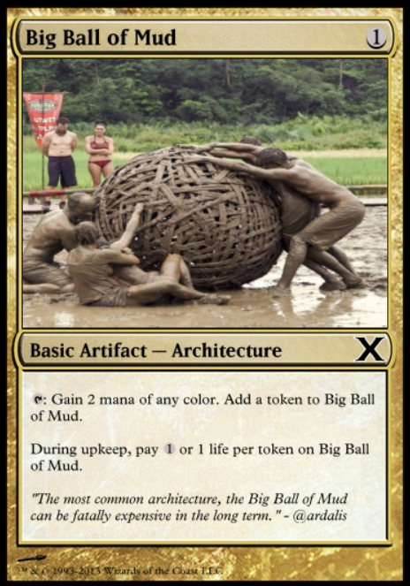
From All-In-One to Clean Architecture
All-in-one (The Big Ball of Mud)
Lack of Clear Structure: The architecture is characterized by a lack of formal structure, resulting in an ad hoc design where the system grows organically without a clear plan or organization.
High Maintenance Costs: Due to the absence of modularity and clear separation of concerns, maintaining and extending the system becomes difficult and costly over time.
Poor Scalability and Reliability: As the system evolves, the entangled codebase can lead to significant issues with scalability and reliability, making the system fragile and prone to bugs and performance problems.
Ahmed Arebie Tripoli Dev-Club 2024

Slide 77
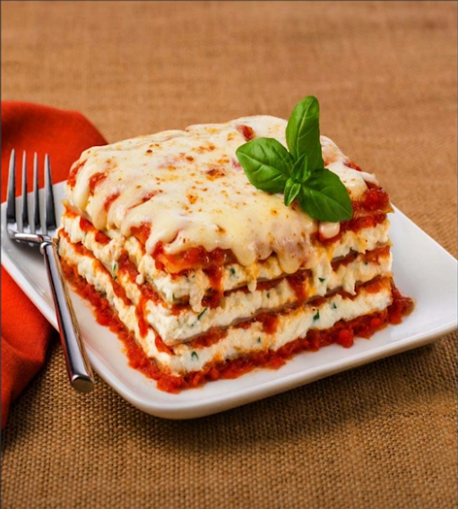
From All-In-One to Clean Architecture
Layers, Moving to “real” layers
Layers make managing complexity easier
Split according to concerns.
Easier to find where certain functionality can be found
Code reuse of DRY .
Functionality can be replaced: less impact on the application, Also for testing purposes.
Easier to maintain, Coupling is a bit loose
Ahmed Arebie Tripoli Dev-Club 2024

Slide 78
From All-In-One to Clean Architecture
UI
Layers, Moving to “real” layers
Layers make managing complexity easier
Split according to concerns.
Easier to find where certain functionality can be found
Code reuse of DRY .
Functionality can be replaced: less impact on the application, Also for testing purposes.
Easier to maintain, Coupling is a bit loose
BL
DAL
DB
Ahmed Arebie Tripoli Dev-Club 2024

Slide 79
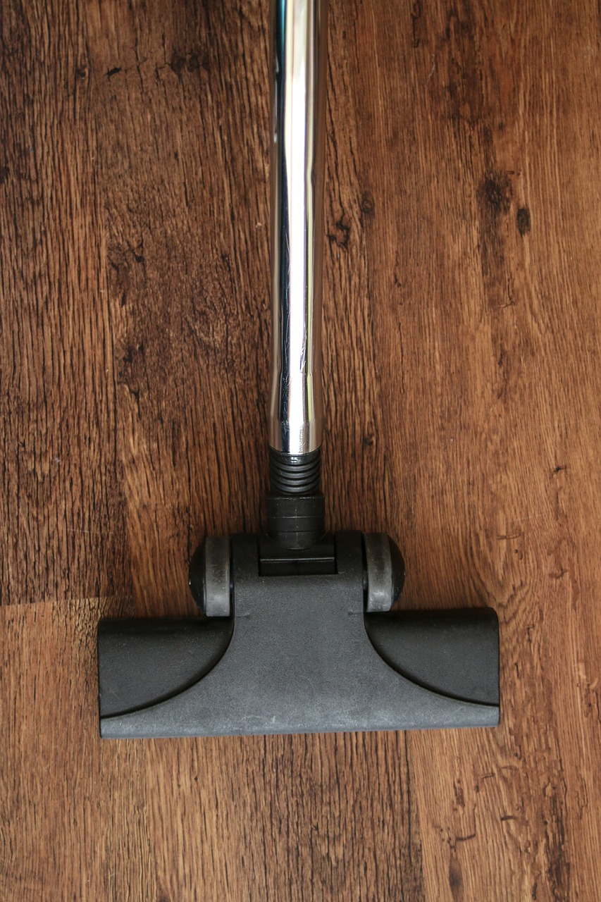
From All-In-One to Clean Architecture
Clean Architecture
More or less same as Onion, Hexagonal, architecture.
Often “linked” with DDD not required though.
In CA, business logic and app model are the center of the application.
BL typically depends on DAL, here dependency inverted.
Ahmed Arebie Tripoli Dev-Club 2024

Slide 80
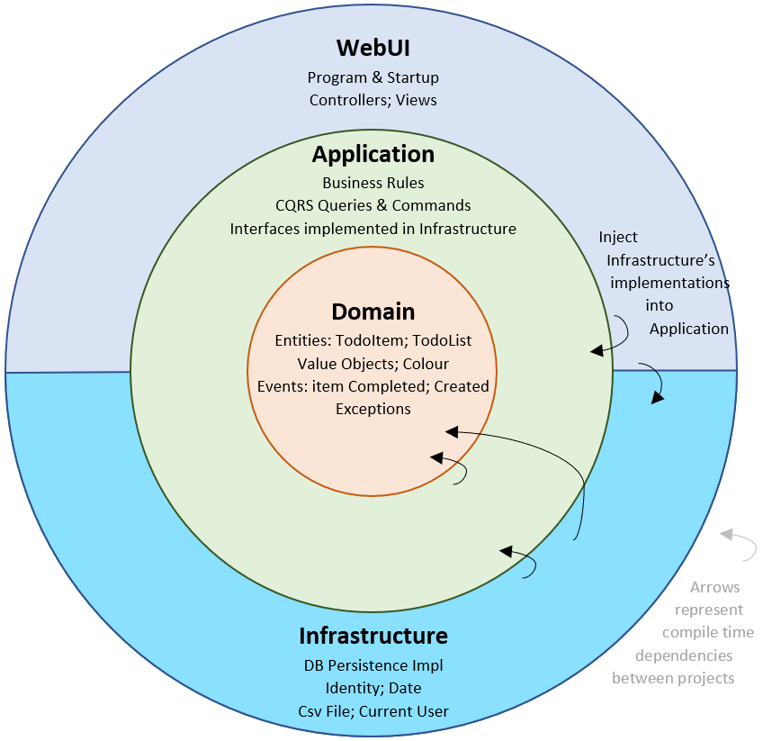
From All-In-One to Clean Architecture
Clean Architecture
Who goes where?
Domain model: Entities, Aggregates
Application core: Services, Interfaces for operations performed through the Infrastructure, DTO (non-entity types), Exceptions…etc.
Core should NEVER have a dependency on Infrastructure
Infrastructure: Data access implementations, Context, Migrations, Repositories, 3rd party's API’s, Logging, SMS, File access.
UI: startup, controllers, filters, configurations, ..etc.
UI have dependency on Infrastructure because the DI.
Ahmed Arebie Tripoli Dev-Club 2024

Slide 81
From All-In-One to Clean Architecture
Clean Architecture
Solid arrows are compile-time dependencies, dashed are runtime.
UI needs to work with interfaces defend in core and knowledge about the implementation in the infrastructure, will need to be resolved at runtime using DI
UI
Infrastructure
Tests
App core
Ahmed Arebie Tripoli Dev-Club 2024

Slide 82
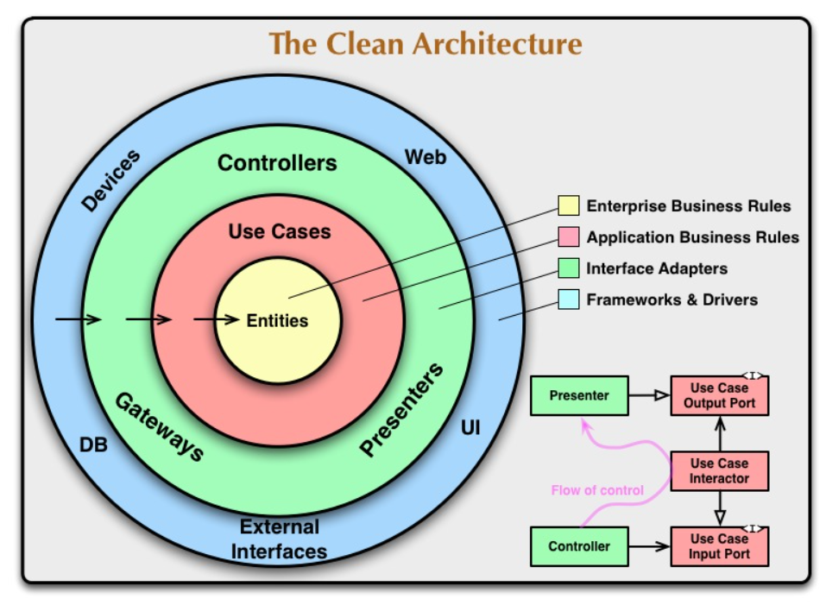
From All-In-One to Clean Architecture
Clean Architecture
Application core
Repo Interface
Infrastructure SQL Repo
DB
Infrastructure NoSQL Repo
DB
Ahmed Arebie Tripoli Dev-Club 2024

Slide 83
From All-In-One to Clean Architecture
Clean Architecture
Application core
Repo Interface
Infrastructure SQL Repo
DB
Infrastructure NoSQL Repo
DB
Ahmed Arebie Tripoli Dev-Club 2024

Slide 84

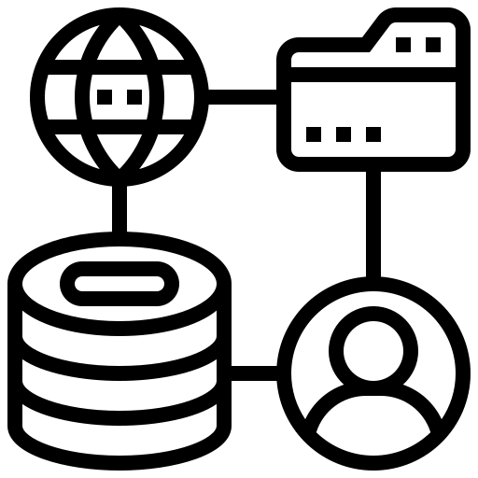
From Software Architecture to Software Desing
Server-Side Application
Ahmed Arebie Tripoli Dev-Club 2024

Slide 85


From Software Architecture to Software Desing
Server-Side Application
Ahmed Arebie Dev-Summit 2024

Slide 86
From Software Architecture to Software Desing
Server-Side Application
Ahmed Arebie Dev-Summit 2024

Slide 87
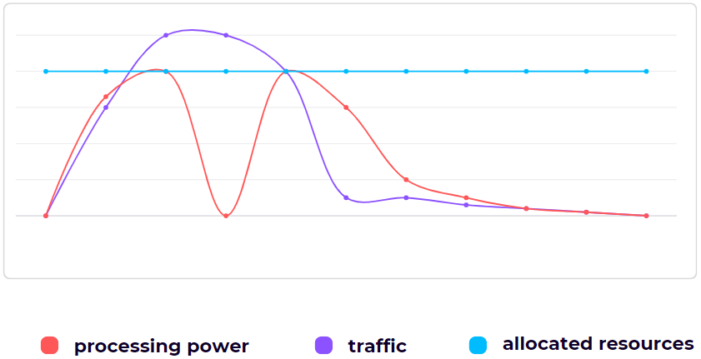
From Software Architecture to Software Desing
Server-Side Application
Ahmed Arebie Tripoli Dev-Club 2024

Slide 88
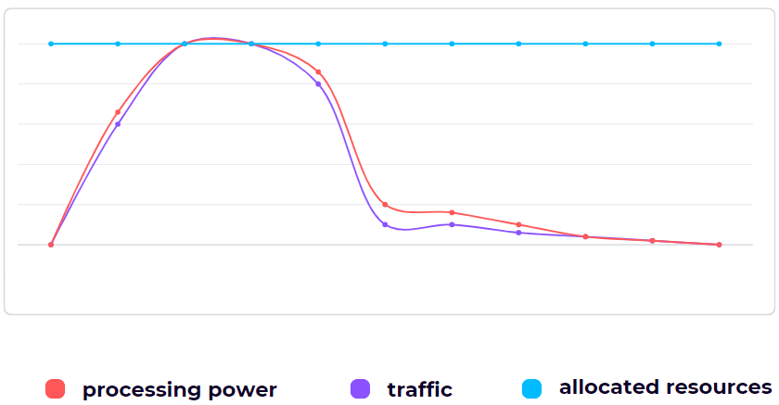
From Software Architecture to Software Desing
Server-Side Application
Ahmed Arebie Tripoli Dev-Club 2024

Slide 89
From Software Architecture to Software Desing
Server-Side Application
Take Advantage of Separation of Concerns
Back-end processing
Frontend-processing
Ahmed Arebie Tripoli Dev-Club 2024

Slide 90
From Software Architecture to Software Desing
Server-Side Application
Take Advantage of Separation of Concerns
DLL
UI
App core Interface
Ahmed Arebie Tripoli Dev-Club 2024

Slide 91
From Software Architecture to Software Desing
Server-Side Application
Take Advantage of Separation of Concerns
Sync
GRPC
UI
UI-GRPC
App core Interface
Ahmed Arebie Tripoli Dev-Club 2024

Slide 92
From Software Architecture to Software Desing
Server-Side Application
Event Driven System
EX: Telecoms & Banks
Ahmed Arebie Tripoli Dev-Club 2024

Slide 93
From Software Architecture to Software Desing
worker queue pattern
Event Driven System
Async !
DB
Manage the traffic
Ahmed Arebie Tripoli Dev-Club 2024

Slide 94
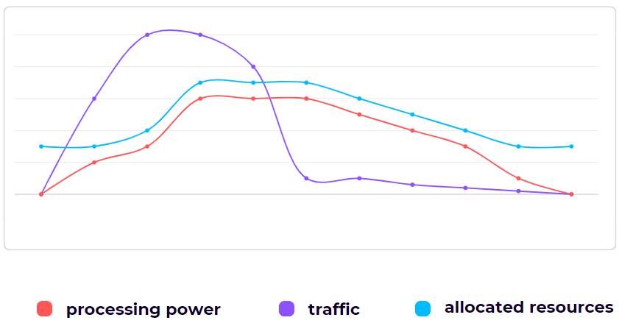
From Software Architecture to Software Desing
Server-Side Application
Ahmed Arebie Tripoli Dev-Club 2024

Slide 95
From Software Architecture to Software Desing
Server-Side Application
UI controller based on http requests
Core Interface
UI based on AMQP
.
.
.
Ahmed Arebie Tripoli Dev-Club 2024

Slide 96
From Software Architecture to Software Desing
Server-Side Application
UI controller based on http requests
Core Interface
UI based on AMQP
.
.
.
Ahmed Arebie Dev-Summit 2024

Slide 97
THANK YOU
Any Questions ?
Ahmed Arebie Tripoli Dev-Club 2024

